Slide 1




Dare to stream!
Thank you for Streaming for Willow.
By streaming and being part of #TeamWillow you are helping to create Special Days, Breaks and Treats for seriously ill young adults aged 16-40, enabling them to make precious memories with their loved ones.

Slide 2


The impact
Our bespoke Special Days, Breaks and Treats are often humble requests that offer much-needed distraction from living with illness, even just for a few precious hours. They offer:
99% of beneficiaries said it gave them
opportunity to
spend quality
time with
loved ones
100% of beneficiaries said it gave them
A focus away from illness and long-term treatment
Starting a treatment journey as a cancer patient or receiving the diagnosis of a life-long degenerative or genetic condition is devastating for young adults and families.
something to
look forward to
99% of beneficiaries said it was an
A chance for beneficiaries to reconnect with family or friends
We offer young people and their families the opportunity to spend uncomplicated quality time together while pursuing an activity that injects a little normality.
opportunity to
create precious
memories
99% of beneficiaries said that it had a
An opportunity to create precious memories
Our experiences lift spirits from the moment they are in the diary. They also give precious memories to look back on, which is especially important for families facing a terminal diagnosis.
positive impact
on their
mental health

Slide 3
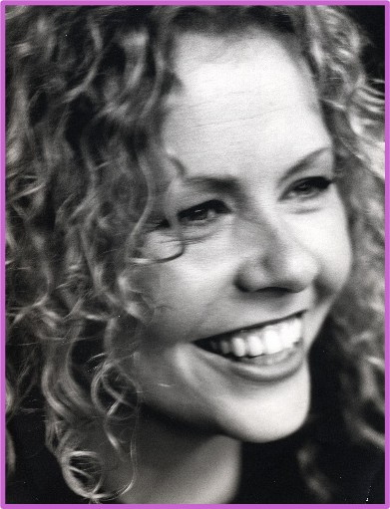
What do Willow do?
Willow was founded in 1999 by Bob Wilson and his late wife, Megs, in memory of their daughter, Anna, who lost her life at the age of 31 after battling cancer for five years. During these challenging years, Anna created some truly unforgettable moments together with her family and friends.
Anna’s ‘Special Days’, which emphasised quality of life and quality time shared with loved ones, became the inspiration for Willow.
Our bespoke experiences offer our beneficiaries a welcome distraction from the harsh realities of living with a life-threatening illness and can help restore a sense of normality to their lives. Since we were founded, we have supported more than 22,500 seriously ill young adults, aged 16 to 40.
“She taught us that quality of life and quality of time is paramount.”
Bob and Megs Wilson

Slide 4
The Difference
Let people know how far their donation can go. This is great content for your moderators or chat-bots to post in chat to encourage donations
£38
£250
£500
gives a seriously ill young adult a
gives a seriously ill young adult a
gives a seriously ill young adult a
Special Treat
Special Break
Special Day

Slide 5

Support for the
dream stream
Check out the link below for a range of resources to help your JustGiving, Twitch and social media profiles look the part and rally more supporters.
We’ve got overlay assets, social graphics and more!
Streaming for Willow - Willow
Once you’ve signed up, keep a lookout for an email
for a chance to get your hands on a free Willow T-shirt!

Slide 6

Tell everyone about it
@willowfoundation
Don’t forget to let everyone know about your stream!
@willow_foundation
Use our hashtag #StreamForWillow
to shout about your challenge and being part of #TeamWillow
Tag us to get the word out
@Willow_Fdn
Willow Foundation
Willow
search

Slide 7

For more support, please get in touch: harry.folgate@willowfoundation.org.uk
Good Luck!

